Slide 1


PES Modern College of Engineering, Pune Department of Information Technology
Project Based Learning Presentation
On
“STUDY TRACKER”
By
1.Sanika Jadhav
2.Pravin Kale
3.Harshad Khalate
4.Mujeeb Khan
5.Aaditya Kothari
Mentor
Vandana Dixit

Slide 2
PROJECT DETAILS
Project Title : STUDY TRACKER
Project Domain : EDUCATION
Project Platform: Android Application
Project Group Members:
- (27027), Sanika Jadhav
- (27031), Pravin Kale
- (27034), Harshad Khalate
- (27035), Mujeeb Khan
- (27037), Aaditya Kothari

Slide 3
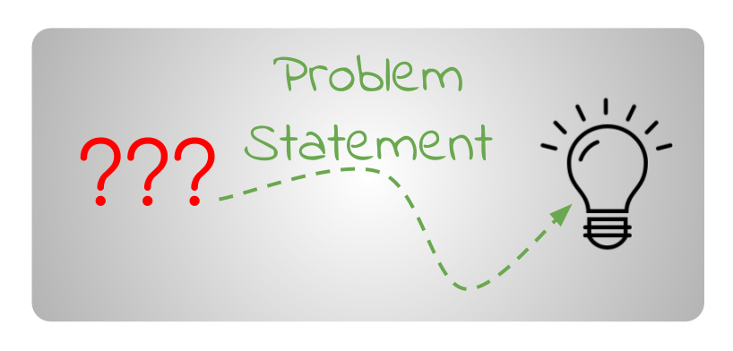
PROBLEM STATEMENT
To maintain a continuous tracking of students progress data helps student/parents/teachers to make sure that the process of education works according to expectations.

Slide 4


AIM
To keep student focused and productive towards Study and their Goals

Slide 5
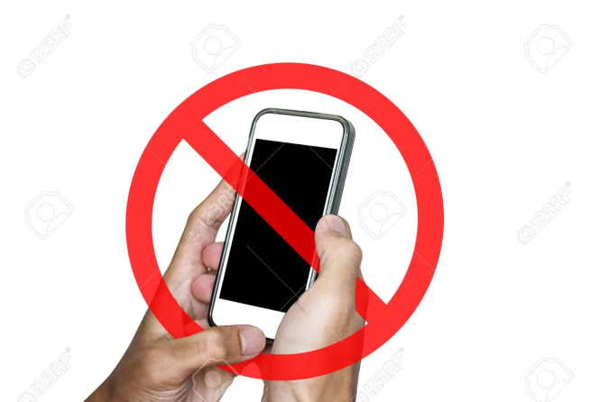

INTRODUCTION
It’s time to take back control and unleash your productivity.
Break phone addiction, eliminate distractions, and maximize productivity easily.

Slide 6


Motivation
Developing good studies habits
Time Management

Slide 7
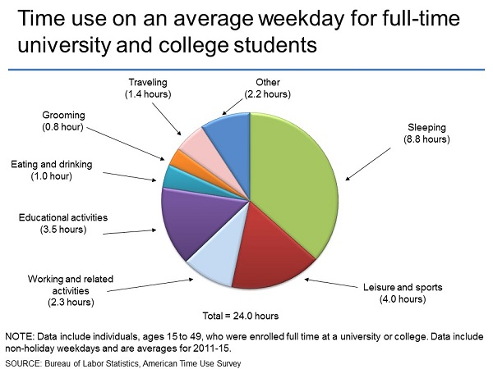

OBJECTIVE
Track progress and display in graphical format
Schedule a weekly study plan

Slide 8
ORIGIN OF IDEA
Student get Distracted due to phones/ Internet
Lack of concentration in self-study due to Online mode of teaching
In existing, there is no as such complete solution to keep a track of Student progress in detailed manner

Slide 9
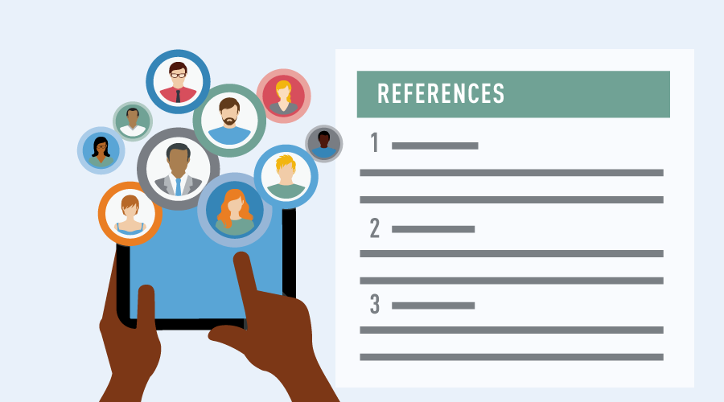
REFERENCES
Some References and Recommendation from Forest App which is also available on Playstore.
https://play.google.com/store/apps/details?id=cc.forestapp
Some References from Survey and Literature by free-management-ebooks.com for proper management of time during study
https://www.google.com/url?sa=t&source=web&rct=j&url=https://edisciplinas.usp.br/mod/resource/view.php%3Fid%3D2058123&vd=2ahUKEwjbmZrEyu_2AhXrpVYBHalvD5sQFnoECBsQAQ&usg=AOvVaw3SO4_1ru0TI81ZFX8U0oE0

Slide 10

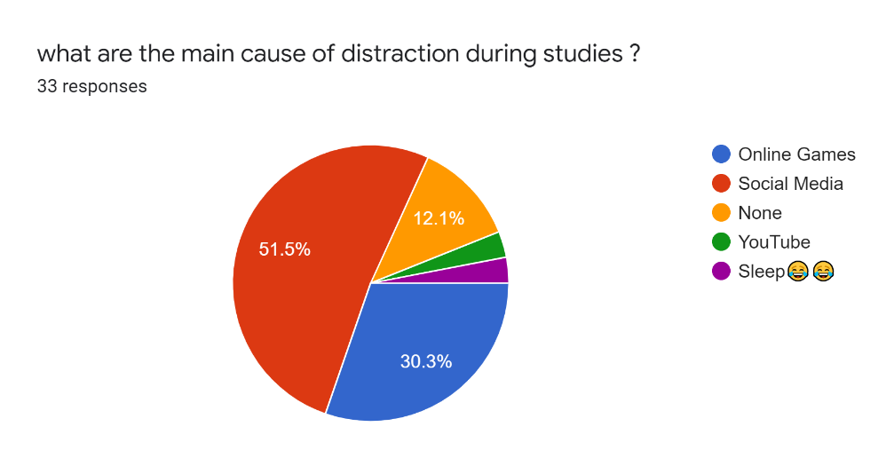
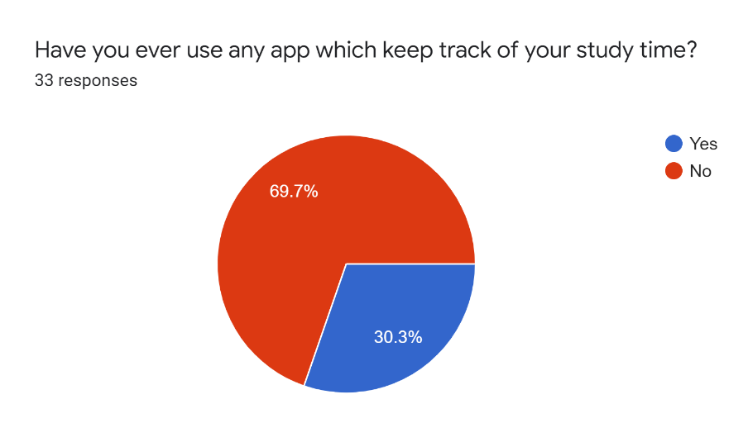
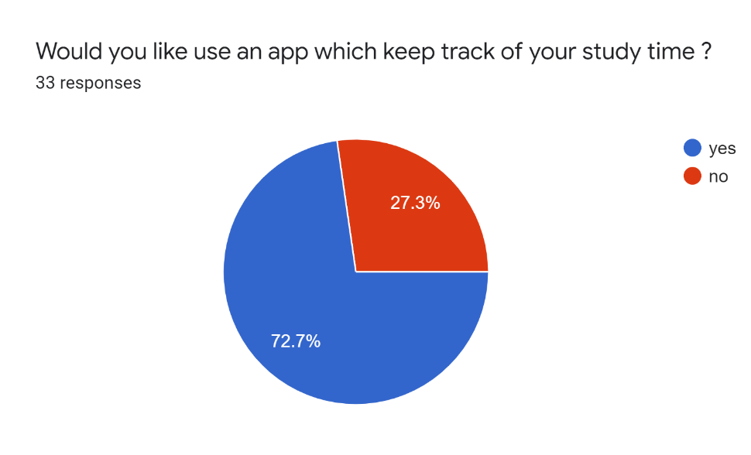
Survey

Slide 11
Future Scope
We will add database so that we can keep trackrack of our progress.
We will proctor student using face detection.
To scale our project we switch to MERN stack.

Slide 12
THANk YOU !!!
Any Questions ???

